Slide 1








Sriram
Personnel Services Pvt Ltd
Company Profile
2023
Office No. 208, Shankar Suman Vishwa, Bhekrainagar, Pune, MH
sriramsecuritiesservices@gmail.com
9284916922 / 9960763396
Scan for visit website
9284916922
srirampersonnelservices
www.srpspl.in

Slide 2
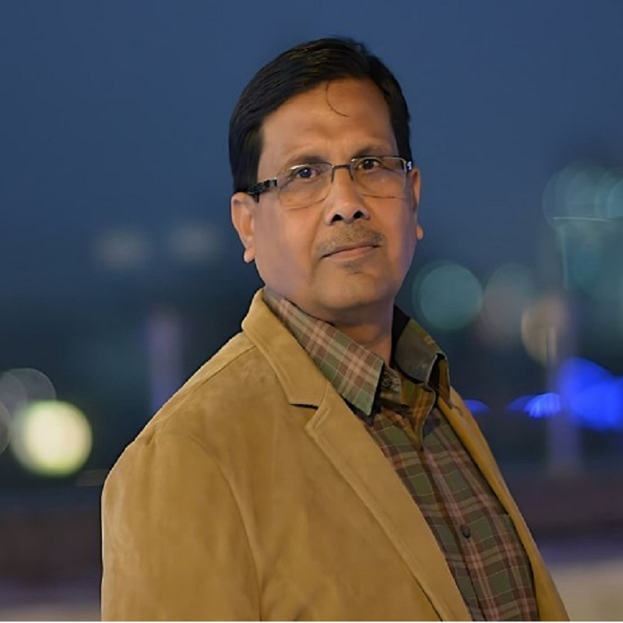
Protecting Your World, Securing Your Peace of Mind

Slide 3
CONTENTS
ABOUT US | 01
OUR TEAM | 02
GALLERY | 03
ACHIEVEMENTS | 04
OUR SERVICES | 05
DIRECTOR’S STATEMENT | 06

Slide 4

01
SRIRAM Personnel Services Pvt Ltd – Be Safe With Us
ABOUT US
Sriram Personnel Services Pvt Ltd is a leading security services provider that has been operating since 2014. We offer a wide range of security solutions, including security guards and personal guards, to meet the diverse needs of our clients.
We are committed to providing our clients with the highest level of service and support. Whether you need security services for your business, event, or personal needs, we have the expertise and resources to deliver the best possible results.
At Sriram Personnel Services Pvt Ltd, we place a strong emphasis on quality and professionalism. Our security personnel are selected through a rigorous screening process and undergo regular training to ensure that they are up-to-date with the latest security techniques and best practices.
Our team of highly trained security personnel is dedicated to ensuring the safety and security of our clients' assets, property, and people. We work closely with our clients to understand their specific security requirements and provide customized solutions that meet their unique needs.
MISSION
VISION
Our mission is to provide our clients with the highest quality security services, customized to meet their specific needs. We are committed to ensuring the safety and security of our clients' assets, property, and people through the use of highly trained and skilled security personnel, advanced security technology, and industry-leading best practices.
Our vision is to be the premier security services provider in our industry, recognized for our commitment to excellence, innovation, and customer satisfaction. We strive to continually improve our services and exceed our clients' expectations, while providing a safe and secure environment for all. We aim to achieve this vision by investing in our people, technology, and processes, and maintaining the highest standards of professionalism and ethics.

Slide 5
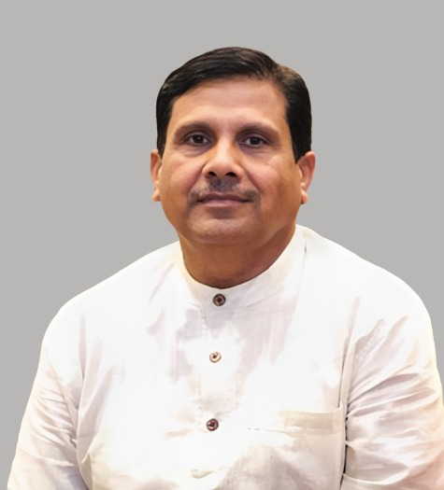
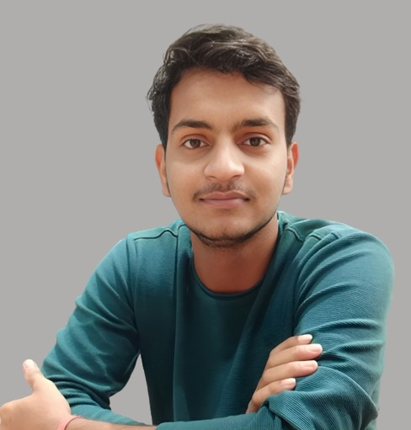
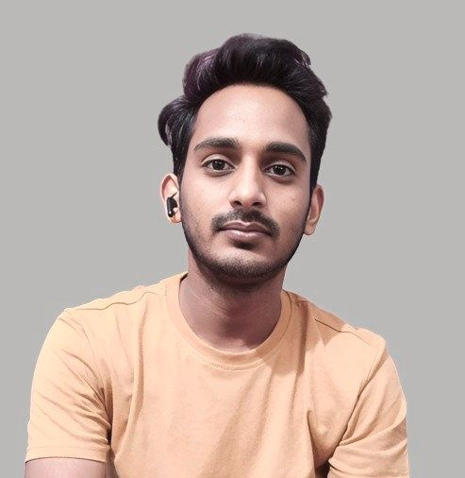

02
SRIRAM Personnel Services Pvt Ltd – Be Safe With Us
OUR TEAM
Our team at Sriram Personnel Services Pvt Ltd comprises highly trained and skilled security personnel who are dedicated to ensuring the safety and security of our clients' assets, property, and people. We believe that our team is our greatest asset and we invest heavily in their training and development to ensure that they are up-to-date with the latest security techniques and best practices.
We also have a team of experienced managers and support staff who work closely with our security personnel to ensure that our services are delivered with the highest level of professionalism and efficiency. Our managers have years of experience in the security industry and are skilled in managing complex security operations and responding to emergencies.
At Sriram Personnel Services Pvt Ltd , we foster a culture of teamwork and collaboration, which enables us to provide our clients with seamless and integrated security services. We work closely with our clients to understand their specific needs and develop customized security solutions that meet their unique requirements.
DK Sharma
CEO
La douleur elle-même est l'amour de la douleur, les principaux problèmes écologiques, mais je donne ce genre de temps pour retomber
Shivam JS
Manager
La douleur elle-même est l'amour de la douleur, les principaux problèmes écologiques, mais je donne ce genre de temps pour retomber
Kaushal Kishor
Admin
La douleur elle-même est l'amour de la douleur, les principaux problèmes écologiques, mais je donne ce genre de temps pour retomber
Professional staff possess specialized knowledge and skills.
Responsible for their work and decisions.
Work efficiently to meet organizational goals.
Collaborate with colleagues to achieve collective success.

Slide 6

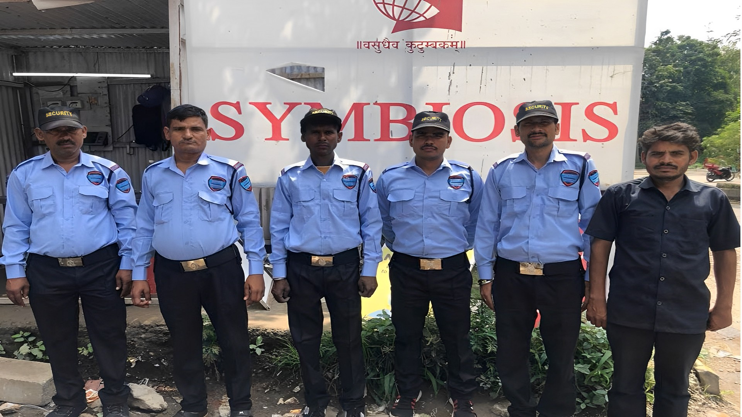
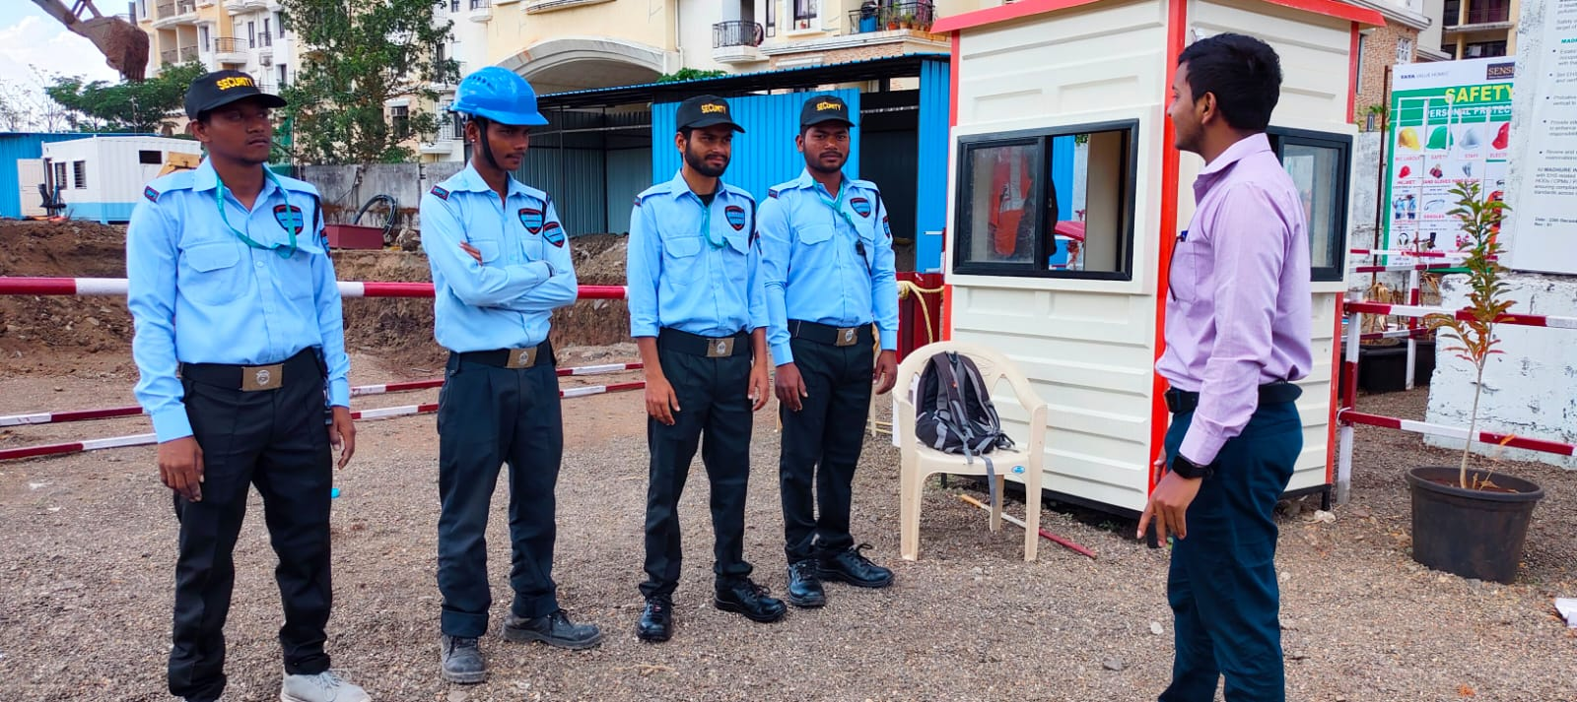
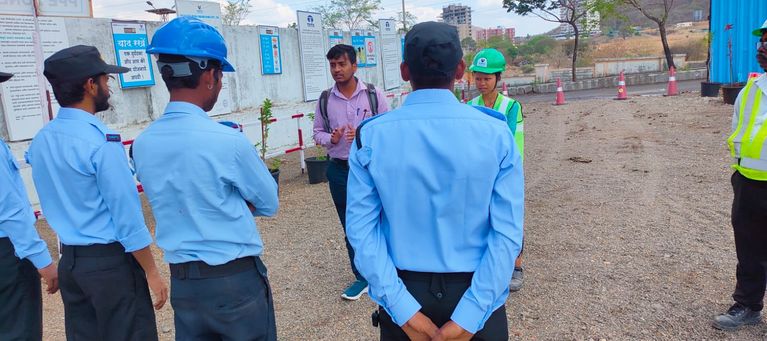
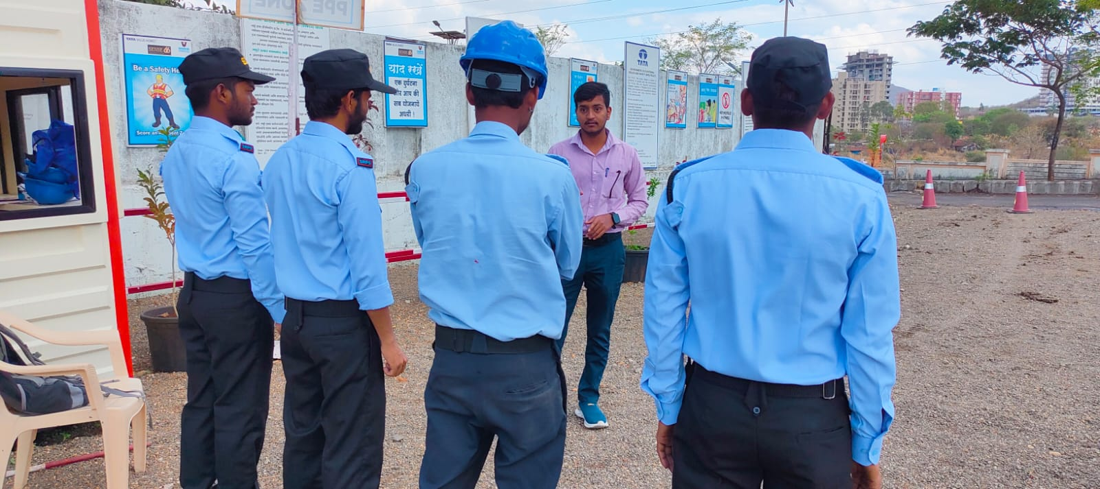
03
SRIRAM Personnel Services Pvt Ltd – Be Safe With Us
Gallery
At our company, we are committed to providing top-quality security services to ensure your safety and peace of mind. Our team of experts utilizes advanced technology and expert monitoring to offer customized solutions that meet your unique needs. Trust us to keep you secure.

Slide 7

04
SRIRAM Personnel Services Pvt Ltd – Be Safe With Us
ACHIEVEMENTS
Sriram Personnel Services Pvt Ltd has achieved high-quality security services that meet the unique needs of clients, earning us a loyal base since our inception in 2014. Our highly skilled personnel use advanced technology for comprehensive security solutions, designed to ensure safety and security. We're known for our commitment to excellence, innovation, and customer satisfaction, with a growing business serving a wide range of clients. These achievements are a testament to our dedication to provide the highest level of security services, and we're proud to continue to serve our clients with excellence in the future.
Our commitment to excellence, innovation, and customer satisfaction has earned us a loyal client base and steady business growth. We continue to expand our services to meet growing needs and remain dedicated to delivering the highest level of security services.
these achievements are a testament to our commitment to providing our clients with the highest level of security services. We are proud of what we have accomplished so far and look forward to continuing to serve our clients with excellence in the future.

Slide 8







05
SRIRAM Personnel Services Pvt Ltd – Be Safe With Us
OUR SERVICES
We are offers customized security services for events, construction sites, offices, and homes. Our skilled and trained personnel provide security guards and personal guards, while our event security services provide crowd management and emergency response. We offer construction-specific personnel and advanced technology solutions for office and home security services. Our solutions are tailored to our clients' unique needs to ensure their safety and security. We are committed to delivering high-quality security services and providing our clients with peace of mind.
Home Security
Protect your home with our expert security services. monitoring to keep your family and property safe.
Office Security
Keep your office safe and secure with our professional security services.
Event Security
Our event security services ensure the safety and protection of your guests, staff, and property.
Industrial Security
We offer advanced industrial security solutions to protect your business and assets.
Personal Security
Our private security services provide discreet and personalized protection for individuals, families.
Transport Security
Our transport security services offer advanced protection for cargo and logistics.

Slide 9
06
SRIRAM Personnel Services Pvt Ltd – Be Safe With Us
DIRECTOR’S STATEMENT
Taking our company further
As the Director of Sriram Personnel Services Pvt Ltd, I am proud to lead a team of highly skilled and trained security professionals. We are committed to providing our clients with the highest level of security services and meeting their unique needs. Our solutions are designed to ensure the safety and security of our clients' assets, properties, and people. We believe in investing heavily in our personnel, providing them with the latest security techniques and best practices. Our reputation in the security industry is built on our commitment to excellence, innovation, and customer satisfaction. We are dedicated to exceeding our clients' expectations and look forward to continuing to serve them with excellence in the future.
“Building our bridge towards success”
DK Sharma (CEO)
I am committed to our mission of providing high-quality security services to our clients. Our achievements to date are a testament to our commitment to excellence, innovation, and customer satisfaction. We look forward to continuing to serve our clients with excellence and to building lasting relationships based on trust and mutual respect.

Slide 10





SRIRAM PERSONNEL SERVICES PVT LTD
Be Safe With Us !
020 4651 0447
sriramsecuritiesservices.com
Bhekrainagar, Hadapsar, Pune, MH
www.srpspl.in

